Slide 1
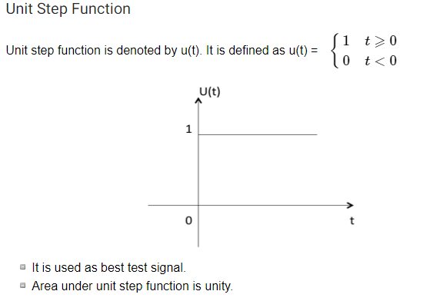

Slide 2
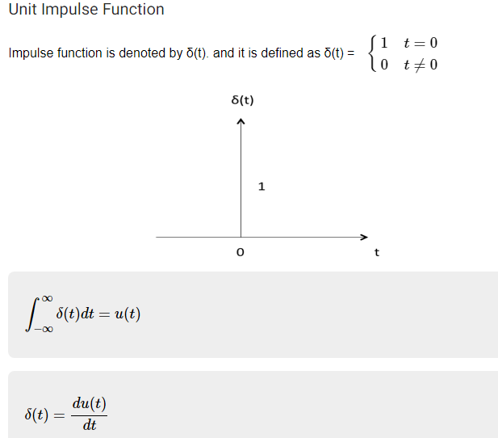

Slide 3
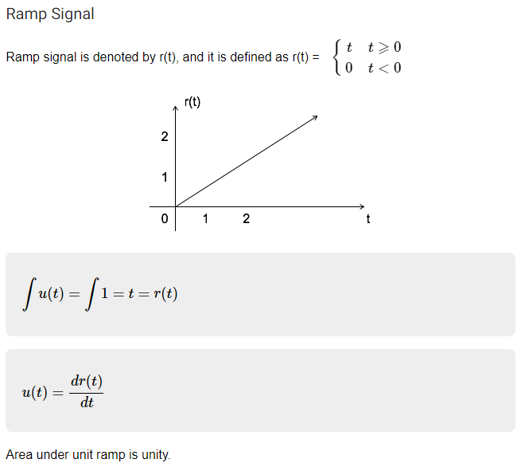

Slide 4
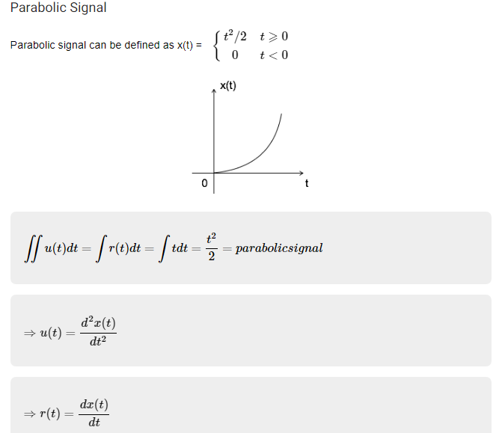

Slide 5
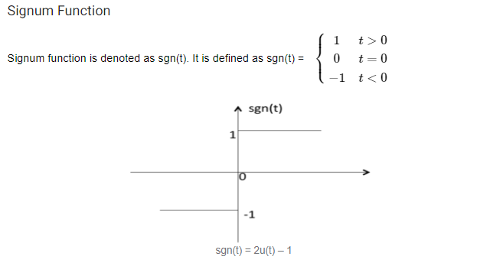

Slide 6

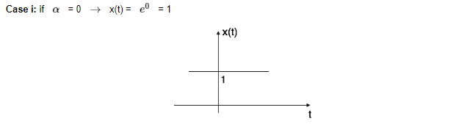
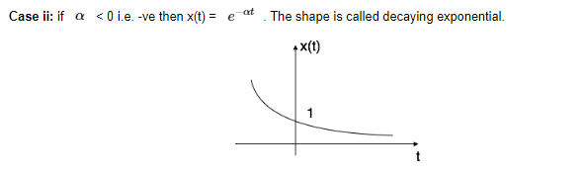
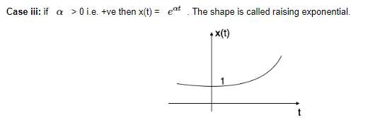

Slide 7
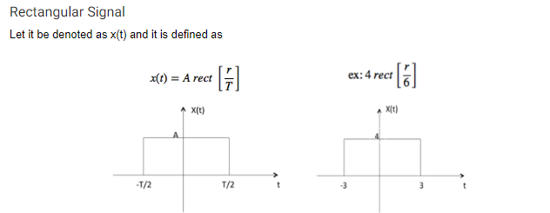

Slide 8
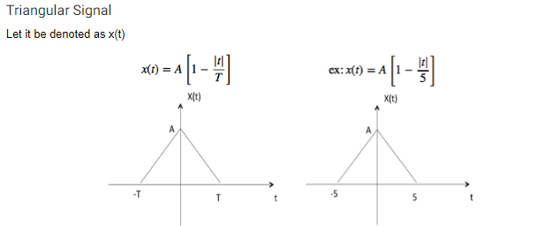

Slide 9
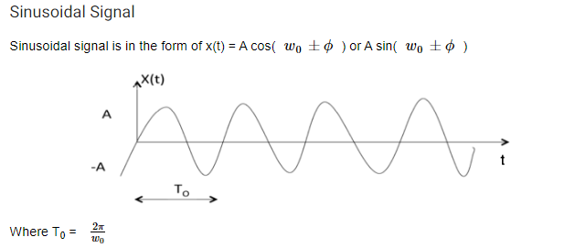

Slide 10
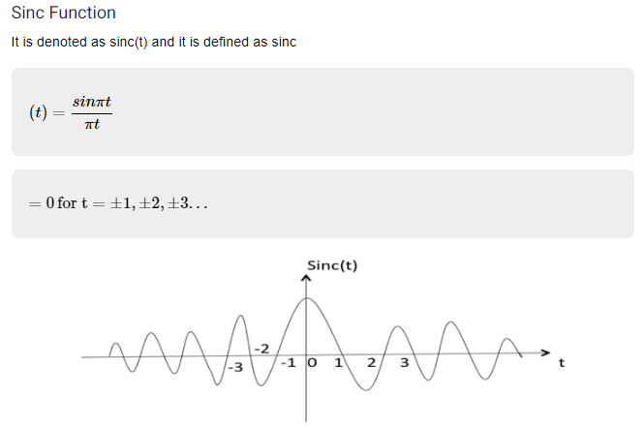

Slide 11
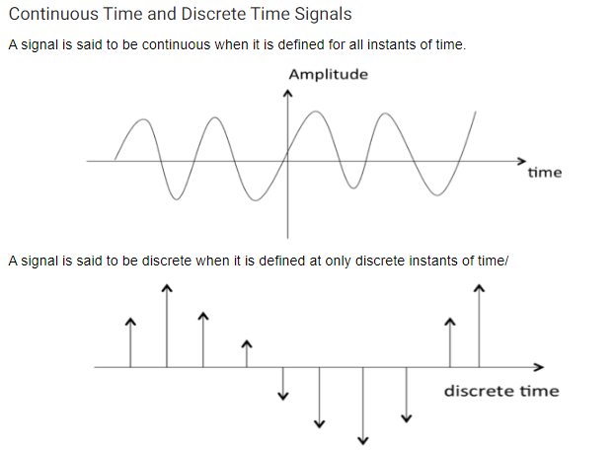

Slide 12
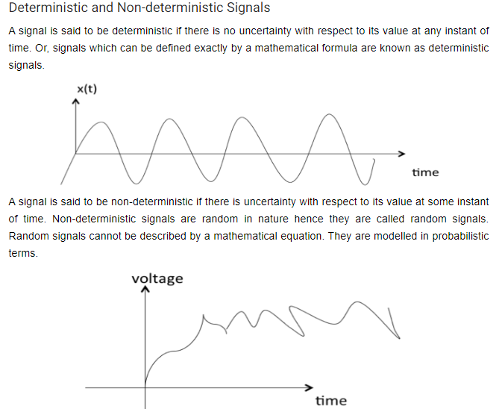

Slide 13
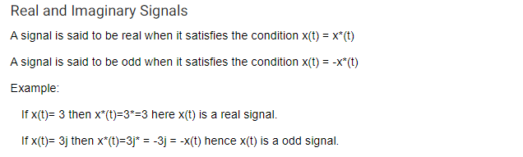

Slide 14
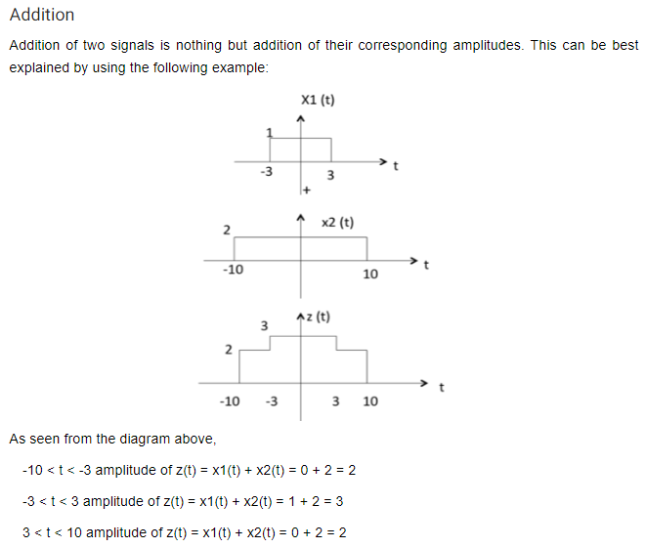

Slide 15
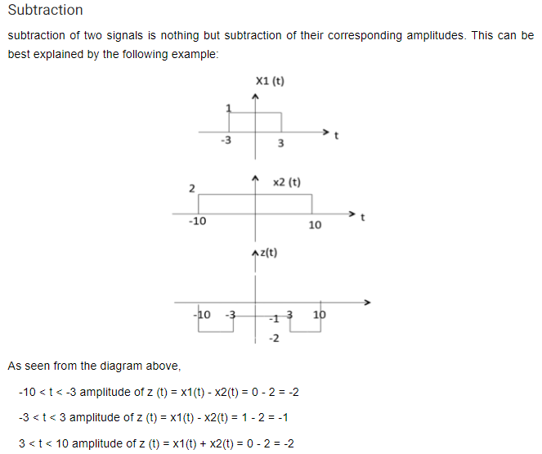

Slide 16
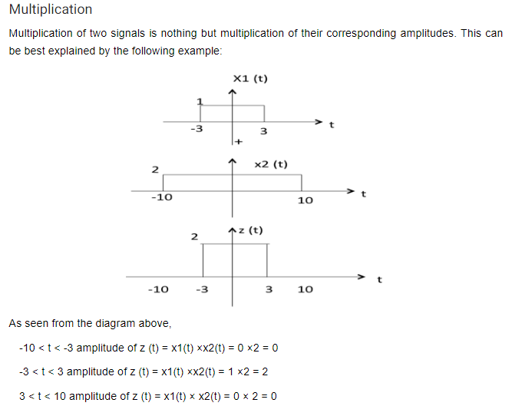

Slide 17
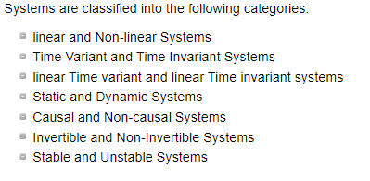

Slide 18
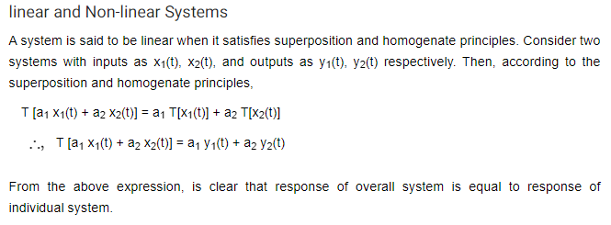

Slide 19
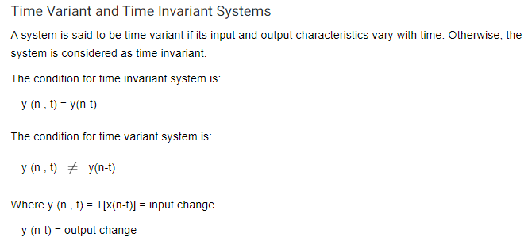
y(n) = x(-n)
y(n, t) = T[x(n-t)] = x(-n-t)
y(n-t) = x(-(n-t)) = x(-n + t)

Slide 20
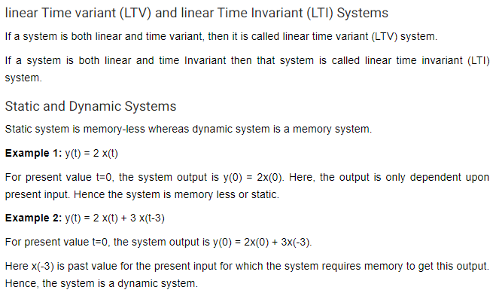

Slide 21
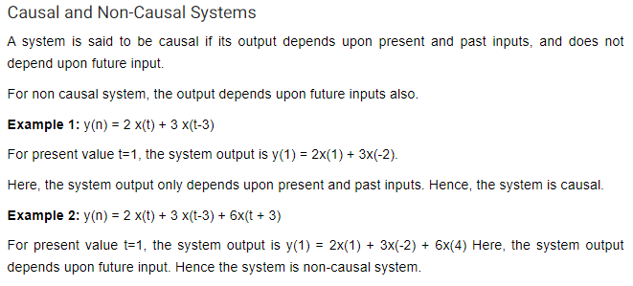

Slide 22
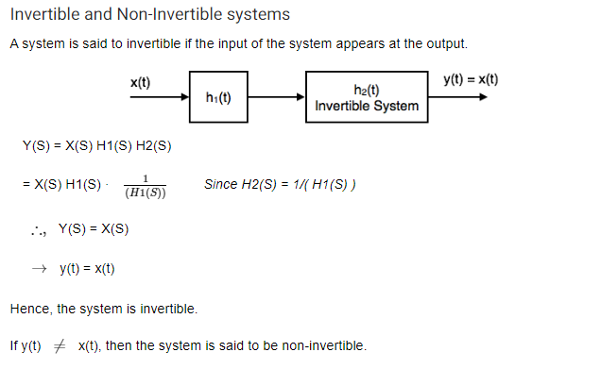

Slide 23
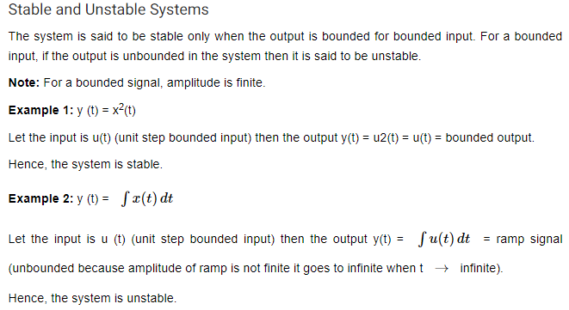

Slide 24
Convolution

Slide 25
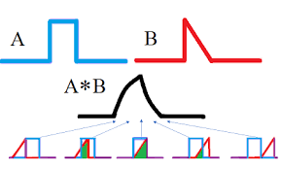
Instantaneous multiplication between two signals

Slide 26
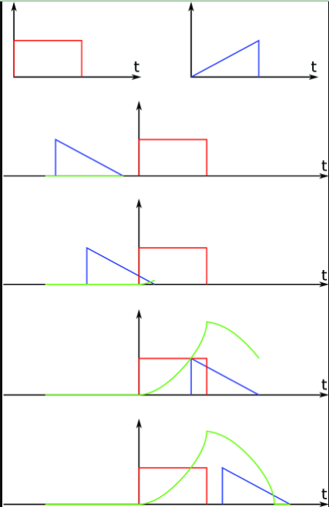
Instantaneous multiplication between two signals

Slide 27
Convolution
Convolution is a mathematical operation used to express the relation between input and output of an LTI system. It relates input, output and impulse response of an LTI system as
y(t)=x(t)∗h(t)
types of convolutions:
Continuous convolution
Discrete convolution

Slide 28
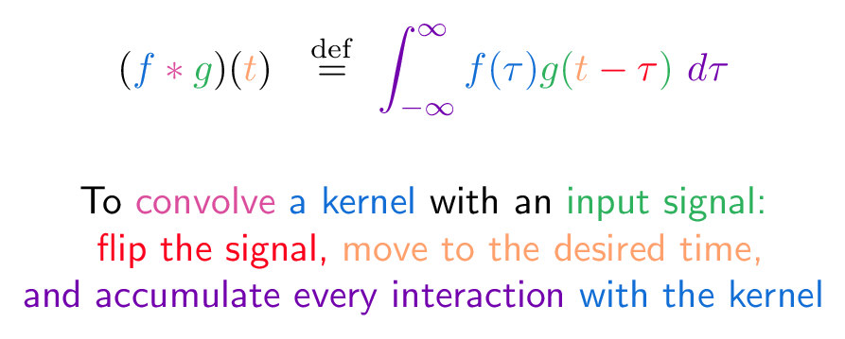

Slide 29

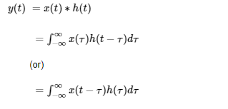

Slide 30

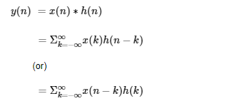

Slide 31
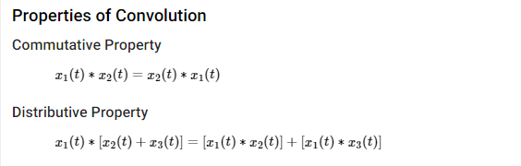

Slide 32
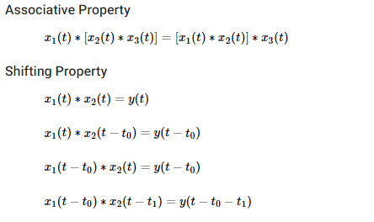

Slide 33
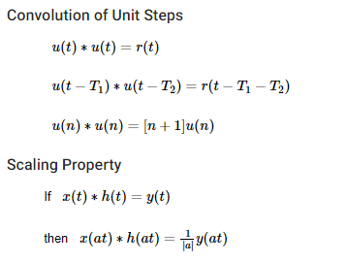

Slide 34
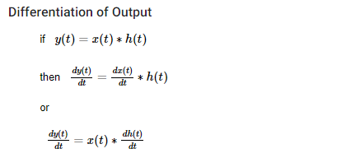

Slide 35
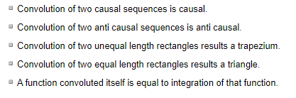

Slide 36
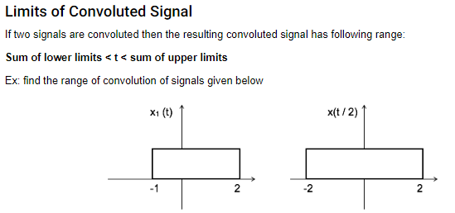

Slide 37
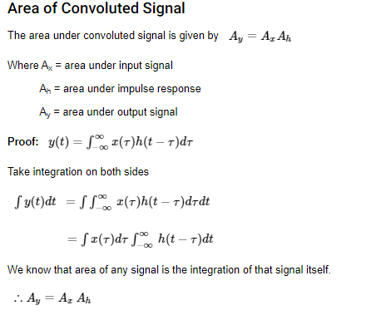

Slide 38
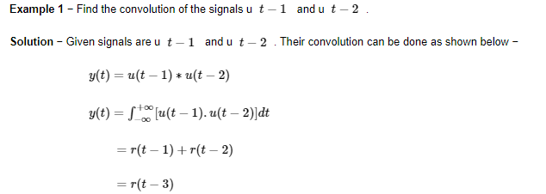

Slide 39
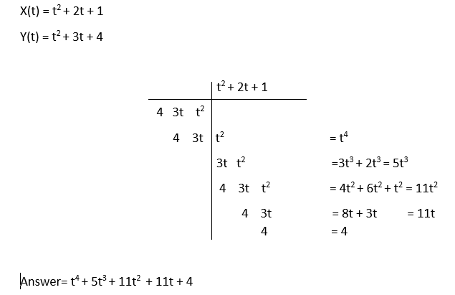

Slide 40
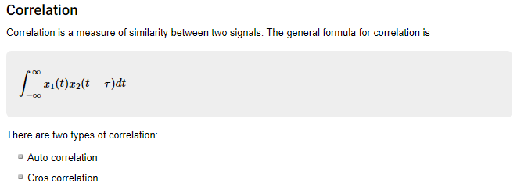

Slide 41
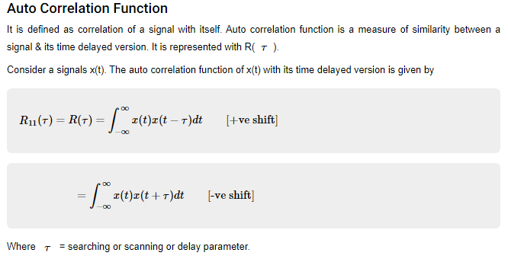

Slide 42
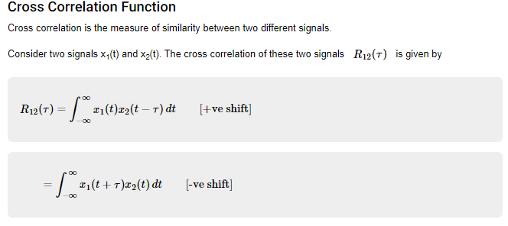

Slide 43
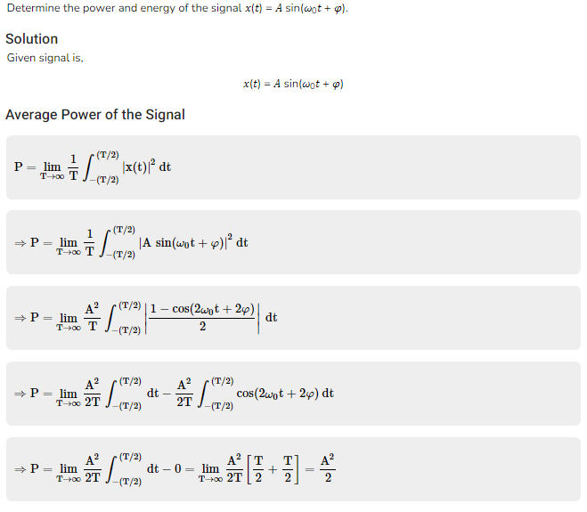

Slide 44
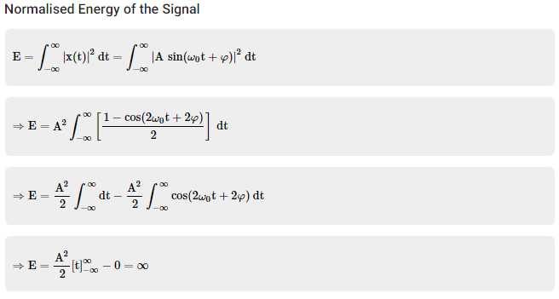

Slide 45
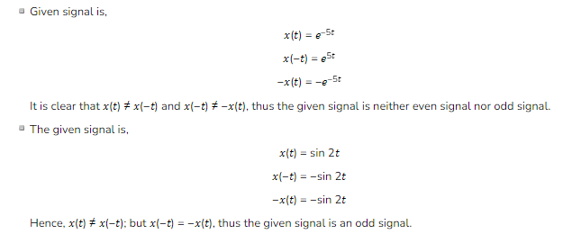
EVEN or ODD Signals Problem

Slide 46
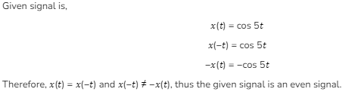

Slide 47
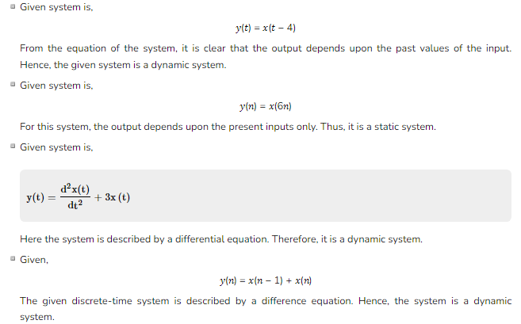
Static or Dynamic System Problem

Slide 48
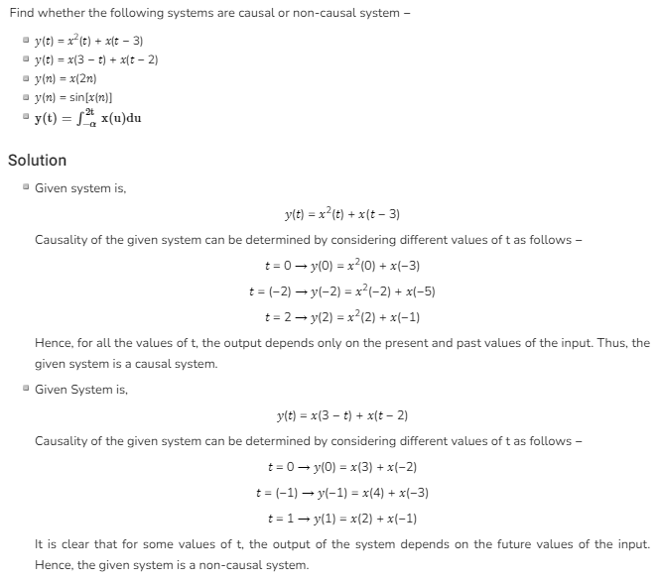

Slide 49
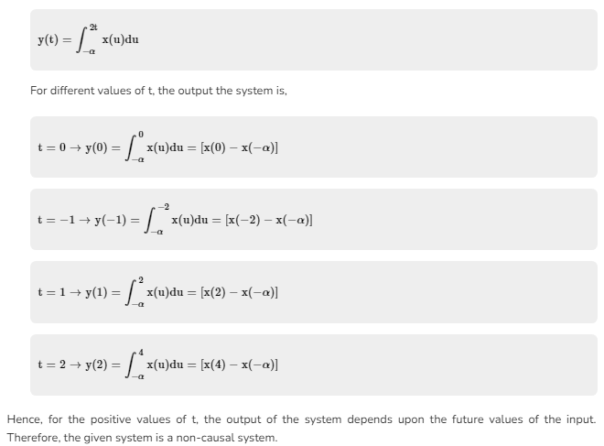

Slide 50
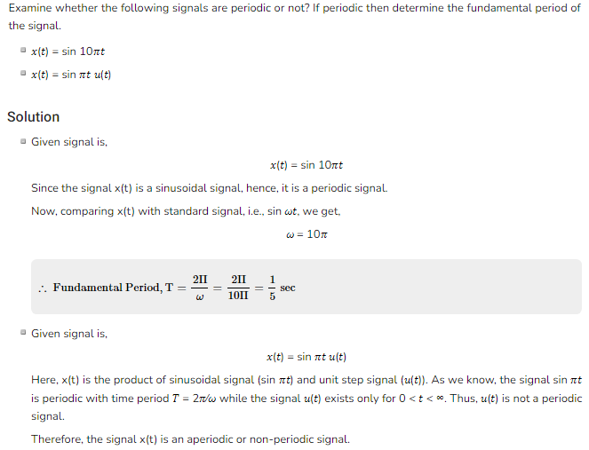

Slide 51


Slide 52

Fourier Series

Slide 53


Slide 54


Slide 55


Slide 56


Slide 57


Slide 58
Joseph Fourier: 1768-1830
A Fourier series is an expansion of a periodic function f(x) in terms of an infinite sum of sines and cosines. Fourier Series makes use of the orthogonality relationships of the sine and cosine functions.

Slide 59

Fourier series expansion is used for periodic signals to expand them in terms of their harmonics which are sinusoidal and orthogonal to one another
Periodic signal : CT – CTFS
DT– DTFS
Non Periodic Signals: CTFT and DTFT
Laplace Transform: Design Purpose (Continuous Signals) (CT)
Z Transform Design Purpose (Continuous Signals) (DT)

Slide 60


Slide 61


Slide 62

Basic Fourier Series Expansion
X(t) = 2 sin wt + sin 2wt + 7 sin3wt + …………………
even harmonic odd harmonic
Where w = 2*pi*f
Trigonometric Fourier series
Complex exponential FS
Polar or Harmonic FS

Slide 63

Trigonometric Expansion
X(t) = dc average value of x(t) +
a₀ = dc component
a_{n} = cosine components of the harmonics
b_{n} = sine components of the harmonics
x(t) = 4 + 3 cos 2wt + 5 sin2wt + 3cos 3wt + 6sin3wt+……………………
a0 = 4
A2 = 3
b2 = 5

Slide 64


Slide 65


Slide 66
If x(t) symmetric about t axis then a₀ = 0
X(t) – Even signal b_{n} = 0
x(-t) = x(t)
x(t) --- odd signal a_{n} = 0
x(-t) = -x(t)

Slide 67

For square wave Ao = 0
Bn= 0
An != 0
For sawtooth wave :
Ao= 0
An= 0
Bn =! 0

Slide 68


Slide 69


Slide 70

The Fourier Transform is a tool that breaks a waveform (a function or signal) into an alternate representation, characterized by the sine and cosine functions of varying frequencies. The Fourier Transform shows that any waveform can be re-written as the sum of sinusoidal.

Slide 71

Fourier Series gives us a method of decomposing periodic functions into their sinusoidal components. The Fourier Series can also be viewed as a special introductory case of the Fourier Transform, so no Fourier Transform tutorial is complete without a study of Fourier Series.
A Fourier Series, with period T, is an infinite sum of sinusoidal functions (cosine and sine), each with a frequency that is an integer multiple of 1/T (the inverse of the fundamental period). The Fourier Series also includes a constant, and hence can be written as:

Slide 72


Slide 73


Slide 74


Slide 75


